Slide 1
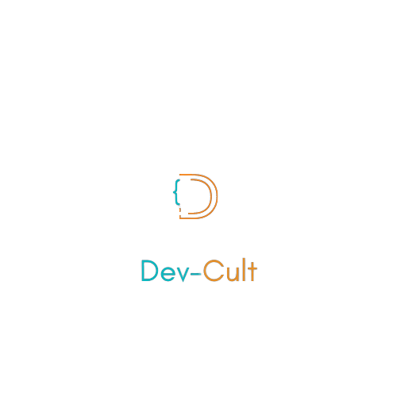

Dive into Open-Source
X

Slide 2
What is Open-Source?

Slide 3




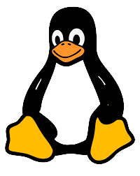

Slide 4
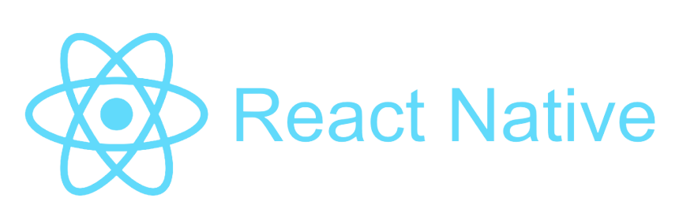

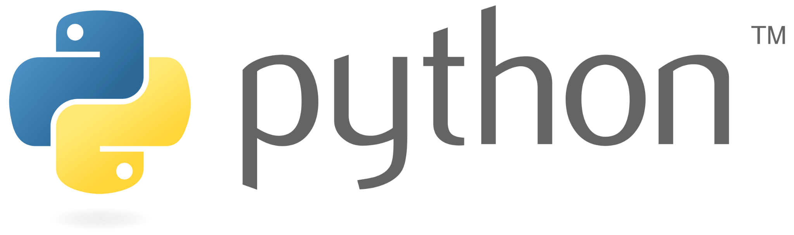

Slide 5
OPEN SOURCE!
Collaboration based software

Slide 6
Open Source
Open source projects are collab based software. In Open source projects the source code is made available for possible modification and redistribution.
This openness enables collaboration.
It makes the software better and increases its efficiency.
So in Open-Source many people contribute to shape a software.

Slide 7
Why should you Contribute to Open- Source Projects?

Slide 8
Great way for a Freshman to Kick-start their journey
For freshman students of 1st and 2nd year the the internship and job opportunities are less, but through open source they can get experience of working in Real-time software projects.

Slide 9
Test Your Skills
While doing the open source contributions you can test your skills and improve your skills according to the need that you feel while contributing to Open-source.

Slide 10
Enhances your Resume
Contributing Open-source projects really enhances your Resume.
If the contribution made by you is impactful it will help your resume stand out.You can find good organizations to make impactful contributions through programs/ websites of programs like GSoC,MLH Fellowship,Microsoft Reinforcement Learning

Slide 11
Networking
Open-Source connects you with some of the great programming minds across the globe.
This helps you to get mentoring and guidance from such people.Also connecting to people is one of the best thing one gets will contributing to Open-Source

Slide 12
Last but not the least
On many famous Open-Source programs offer handsome stipend like $3000 in MLH Fellowship, $5000 in GSoC, $10000 in Microsoft Reinforcement Learning.

Slide 13
Are there any prerequisites? If yes what are the prerequisites?

Slide 14
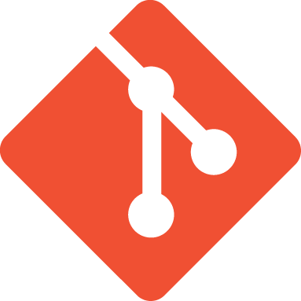


Yes, there are some prerequisite for starting coding contributions to Open Source Projects
Any OOP Language
Any Tech-Stack of your choice
You need to learn any tech-stack of choice according to your interest and acquire basic to intermediate level knowledge in that particular tech-stack to start contributing to Open-Source.
Git and Github/GitLab (Version Control System)
Learning Git, Github/Gitlab is the most important skill one need to have before starting contributing to Open-Source Projects.Also it is one of the most vital skill one software engineering needs to have

Slide 15
That was all about Open-Source
You can find us at:
Instagram:
@devcult_community, @dsc.pdpu
Discord:
https://discord.gg/nSnnVqG9,
https://discord.gg/dFmYUXj7

Slide 16
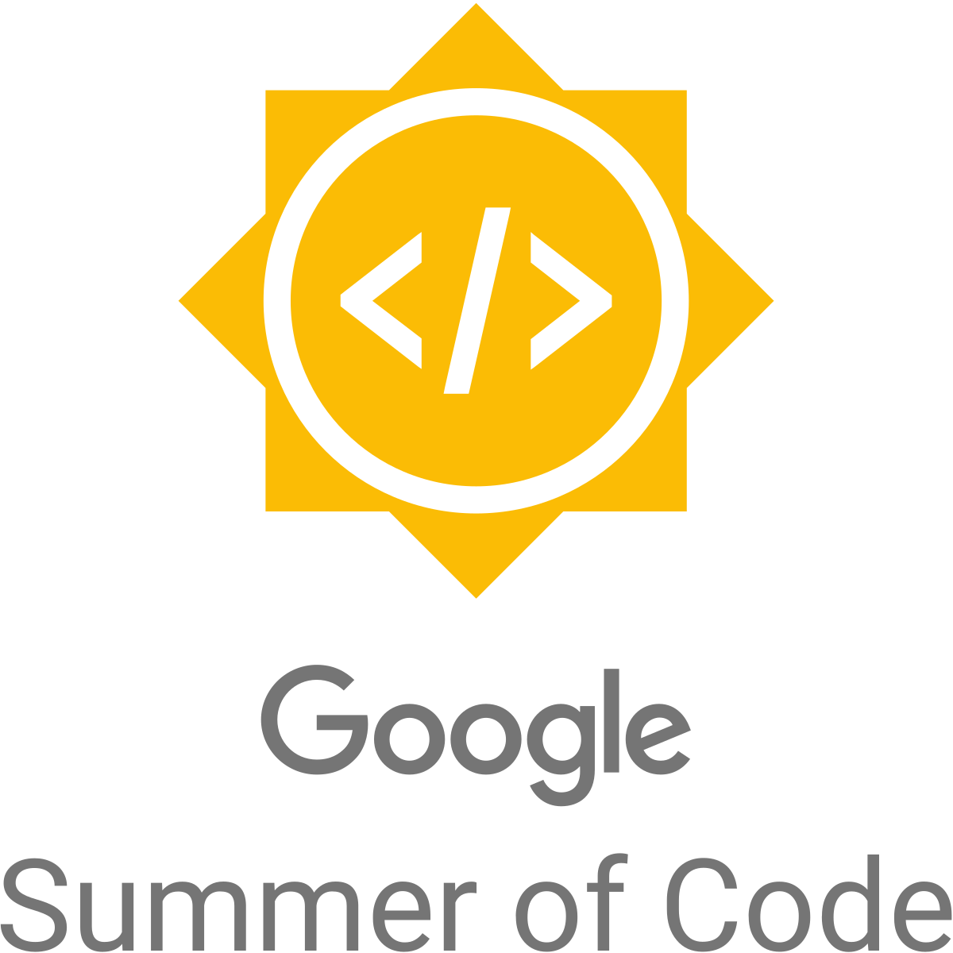
Lets talk about GSoC

